Slide 1





P1382 - ADVENTURE WORKS
DATA ANALYTICS PROJECT
PRESENTED BY : GROUP 3
S MOHAMMAD ZAHEER
KARTHIK S R
BUDDALA SRI LALITHA
PRANAV SANJAY RAJPUT
SAMUEL SIRIVELLA
SHREYAS P M
EXCEL
SQL
TABLEAU
POWER BI

Slide 2
AGENDA
01
ABOUT ADVENTURE WORKS
06
TABLEAU MODULE
02
OBJECTIVE & WORKFLOW
07
POWER BI MODULE
03
ALL ABOUT DATASETS
08
KEY PERFORMANCE INDICATORS
04
MS EXCEL MODULE
09
CHALLENGES & LEARNINGS
05
MYSQL MODULE
10
CONCLUSION

Slide 3




ADVENTURE WORKS — OVERVIEW & BUSINESS GOALS
Industry: Bicycle Manufacturing
Adventure Works Cycles is a multinational bicycle manufacturing company that produces and sells metal and composite bicycles across North America, Europe & Asia.
Its headquarters is in Bothell, Washington, while the manufacturing plant in Mexico produces critical bicycle components.
The company aims to expand its market share, improve customer targeting, reduce production cost, and support better decision-making through data analysis.
Market: North America, Europe, Asia
Headquarters: Bothell, Washington, USA
Manufacturing Plant: Mexico
BUSINESS
GOALS
Increase market share
Expand online sales
Reduce production cost
Improve customer targeting

Slide 4
OBJECTIVE & WORKFLOW
PROJECT OBJECTIVES
PROJECT WORKFLOW
✓
Analyze Sales
Raw Data
✓
Analyze Profit
Microsoft Excel Data Cleaning & Preparation
✓
Analyze Production Cost
SQL Data Analysis & Business Queries
✓
Compare Regional Sales
Tableau Data Visualization
✓
Analyze Product Performance
Power BI Interactive Dashboard & DAX
✓
Build Interactive Dashboards

Slide 5
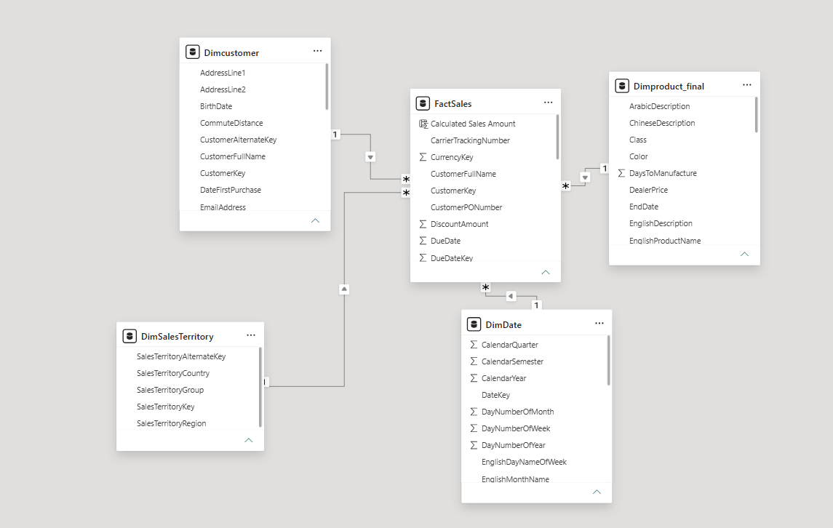
DATASET DESCRIPTION
The Adventure Works dataset contains transactional sales data along with supporting information about products, dates & sales territories.
The dataset follows a Star Schema, consisting of one fact table and multiple dimension tables.
Table Use | Description
Fact Sales | Sales transaction
Product Master Table | Product information
Customers | Customers details
Date | Date analysis
Territory | Country and region details

Slide 6
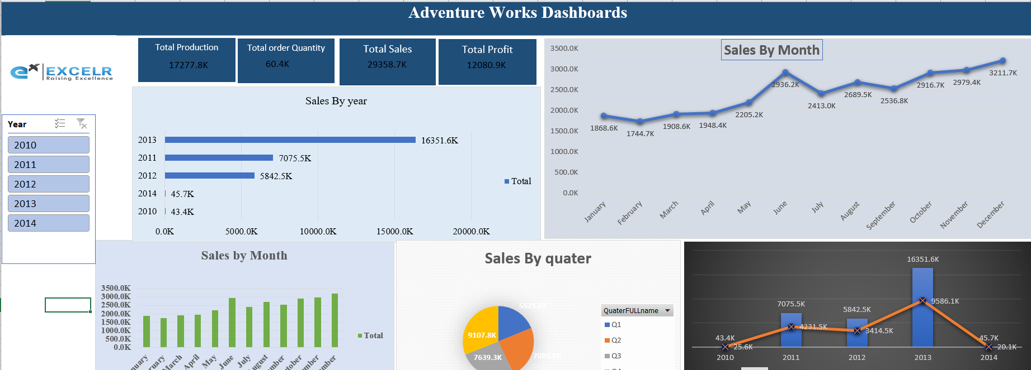
MICROSOFT EXCEL
KEY ACTIVITIES
OUTCOME
✓ Data Cleaning
✓ Data Enrichment
Prepared a clean and validated dataset for analysis.
Automated business calculations using Excel formulas.
Generated interactive pivot reports and charts.
Developed an Excel dashboard to monitor Sales, Profit, Cost, and Orders.
✓ Calculated Columns
✓ Pivot Tables
✓ Charts
✓ Dashboards

Slide 7
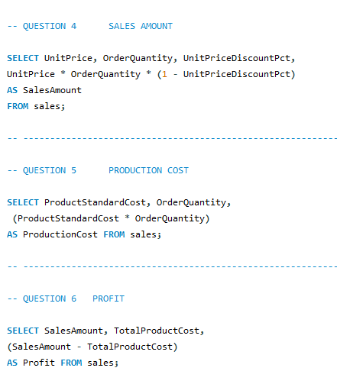
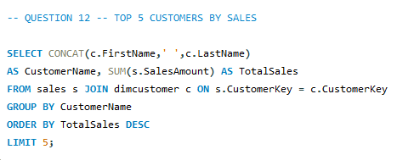
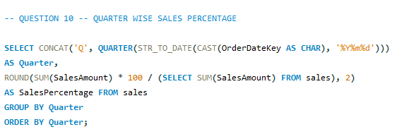
SQL
KEY ACTIVITIES
OUTCOME
✓ SELECT
✓ WHERE
SQL enabled efficient analysis of sales data and answered important business questions.
✓ GROUP BY
✓ HAVING
✓ ORDER BY
✓ Aggregate Functions
✓ INNER JOIN
✓ Window Functions

Slide 8
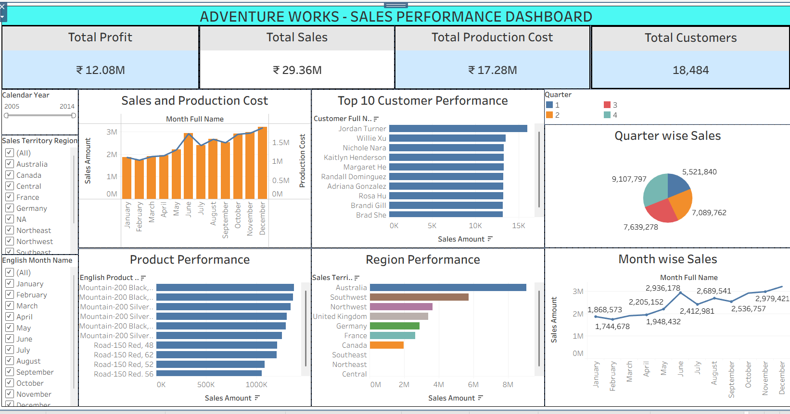
TABLEAU
KEY ACTIVITIES
OUTCOME
✓ Connected Adventure Works Dataset
✓ Built Interactive Dashboard
Built interactive dashboards using Tableau.
Visualized Sales, Profit, Cost, Customer, Product, and Regional performance.
Created meaningful business insights through interactive reporting.
Enhanced decision-making using data visualization techniques.
✓ Applied Filters
✓ Created KPI Cards
✓ Created Sales Trends

Slide 9
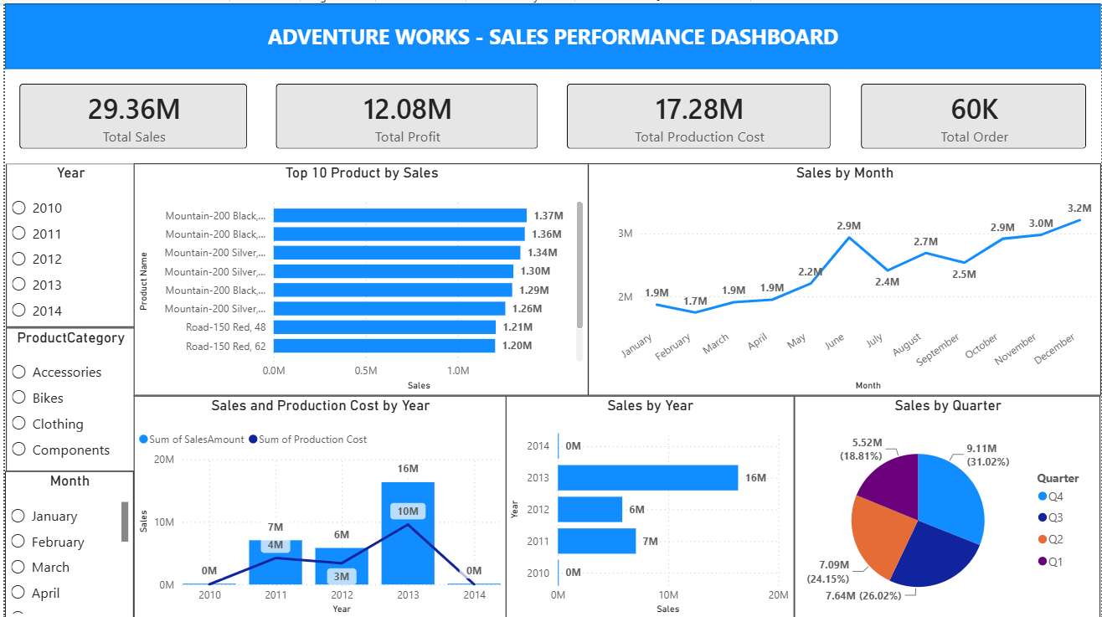
MICROSOFT POWER BI
KEY ACTIVITIES
OUTCOME
✓ Imported Dataset
✓ Created Star Schema
Built an interactive Business Intelligence dashboard.
Created a Star Schema data model with DAX calculations.
Developed KPI cards, charts, maps, and slicers.
Delivered dynamic insights into Sales, Profit, Products, Customers, and Regions.
✓ Established Relationships
✓ Created DAX Columns
✓ Created DAX Measures
✓ Designed Dashboard

Slide 10





BUSINESS INSIGHTS — KEY PERFORMANCE INDICATORS
TOTAL SALES
Total Sales reached ₹29.36 Million.
₹29.36M
Profit Margin is 41.15%.
TOTAL PROFIT
₹12.08M
Around 60,000 Orders were processed.
PRODUCTION COST
United States generated the highest sales.
₹17.28M
2013 recorded the highest sales.
PROFIT MARGIN
Mountain Bikes generated maximum revenue.
41.15%
Production Cost remained lower than Sales, resulting in healthy profitability.
TOTAL ORDERS
60,000

Slide 11
CHALLENGES & LEARNING
CHALLENGES
SKILLS LEARNED
•
Merging multiple datasets
•
Unioned sales tables into one dataset
•
Building the product master
•
Merged product-related tables
•
Creating table relationships
•
Implemented a Star Schema
•
KPI calculations
•
Used Excel formulas, SQL queries, and DAX measures
•
Validating results across tools
•
Cross-verified results in Excel, Tableau, and Power BI
•
Dashboard design & interactivity
•
Added slicers, filters, and KPI cards for interaction

Slide 12
CONCLUSION
Successfully completed an end-to-end Business Intelligence project using the Adventure Works dataset.
Cleaned, transformed, and validated data using Microsoft Excel.
Queried and analyzed business data using SQL.
Built interactive dashboards in Tableau and Power BI for business insights.
Identified key trends in Sales, Profit, Production Cost, Customers, Products, and Regions.
Developed dashboards that support faster, more informed business decision-making.

Slide 13
THANK YOU!
P1382 - ADVENTURE WORKS DATA ANALYTICS PROJECT | GROUP 3

